Slide 1

Build Out Line for 7v7: Creating Confidence for 9/10’s to Play Out of the Back
MISSissippi soccer association
August 2016

Slide 2
Purpose of the Build Out Line
Taken directly from US Soccer:
  The build out line promotes playing the ball out of the back in a less pressured setting.
  When the goalkeeper has the ball, either during play (from the opponent) or from a goal kick, the opposing team must move behind the build out line until the ball is put into play.
  Once the opposing team is behind the build out line, the goalkeeper can pass, throw or roll the ball into play (punting is not allowed).
  After the ball is put into play by the goalkeeper, the opposing team can cross the build out line and play resumes as normal.

Slide 3
Use as a Developmental Tool
The Build Out Line should be used as a developmental tool for the U9’s & U10’s.
The whole purpose is to develop confidence for the 9’s and 10’s to be able to attack out of the back, so as they progress to 11’s and older, it is automatic.
Want to encourage playing from the GK (1) to the Backs (2, 3, 4, 5) and Midfield (6, 8, & 10) as well as the Forwards (7, 9, 11). Obviously, they will be playing 7v7, so not all the positions (#’s) are used, but all the lines of the team are represented some how and in some way.
The Build Out Line should be painted in a dotted line since it is a developmental tool.
The Build Out Line should be painted in a different color from the rest of the boundaries.
For example, you have white lines on the field with a blue dotted Build Out Line.

Slide 4
Where can the players go?
The attacking team (team with the ball) may locate themselves anywhere as they have the advantage.
The defending team (team without the ball) must start from behind the Build Out Line until the ball is put into play.

Slide 5
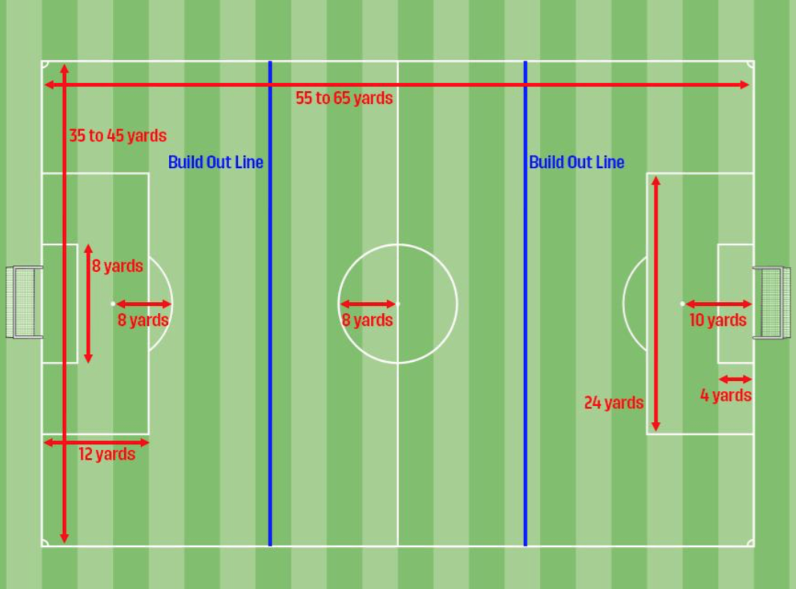
Diagram of Field with Build Out Line
Notice, the Build Out Line is half way between the Penalty Area and Midfield Line.

Slide 6
The Offside Rule
The Offside Rule is in effect here for these age groups.
The Build Out Line will also be used to denote where offside offenses can be called.
Players cannot be penalized for an offside offense between the halfway line and the build out line.
Therefore, players can be “on side” past the opponent’s 2nd to last player but before the Build Out Line in the attacking half.
Players can be penalized for an offside offense between the build out line and goal line.

Slide 7
Counter-Attack
GK has the ability to counter-attack immediately.
Therefore, put the ball into play with the opponent inside the zone (with the risk of losing the ball).

